Slide 1
The Hierarchy of Classification-Groups
All living things are identified and categorized on the basis of characteristics
All living things are identified and categorised on the basis of their body design in form and function.
Some characteristics are likely to make more wide-ranging changes in body design than others.
There is a role of time in this as well.
So, once a certain body design comes into existence, it will shape the effects of all other subsequent design changes, simply because it already exists.

Slide 2
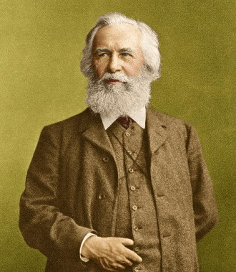
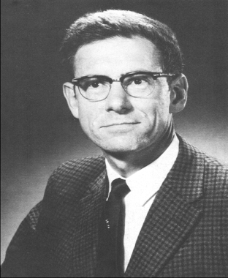
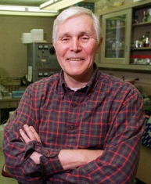
The Hierarchy of Classification-Groups
Biologists, such as
Ernst Haeckel
(1894),
Robert Whittaker
(1959)
Carl Woese
(1977)
have tried to classify all living organisms into broad categories, called kingdoms.

Slide 3
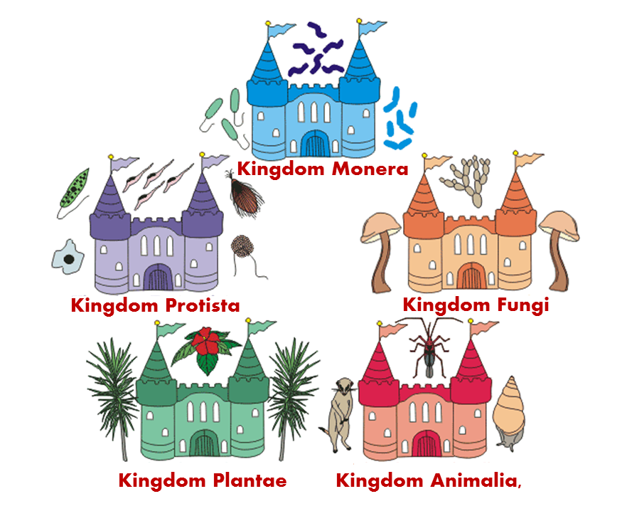
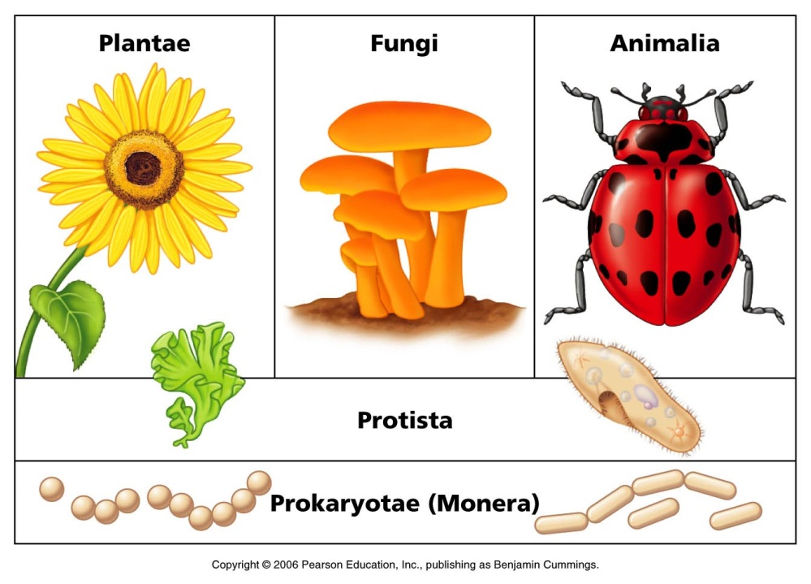
The Hierarchy of Classification-Groups
The classification Whittaker proposed has five kingdoms
These groups are formed on the basis of their cell structure, mode and source of nutrition and body organisation.

Slide 4
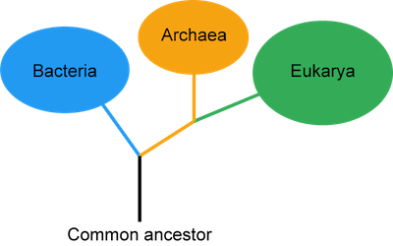
The Hierarchy of Classification-Groups
The modification Woese introduced by dividing the Monera into Archaebacteria (or Archaea) and Eubacteria (or Bacteria) is also in use.
Further classification is done by naming the sub-groups at various levels as follows kingdom.
Phylum
Class
Order
Family
Genus
Species

Slide 5
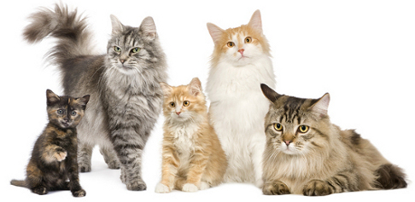


The Hierarchy of Classification-Groups
Thus, by separating organisms on the basis of a hierarchy of
characteristics into smaller and smaller groups, we arrive at the
basic unit of classification, which is a species.
So what organisms can be said to belong to the same species?
Broadly, a species include all organisms that are similar enough to breed and perpetuate.
Keep the species alive
Produce young ones

